Slide 1




Presented by
Amarjeet Malik
Ayushi Goyal
Deepika Tiwari
Prateek Nagar
Sakshi Gupta
Sukirti Kaushik
Surbhi Garg

Slide 2

Skill Council for Green Jobs - Overview
WHAT - One of the most recently launched initiatives of the Government of India aligned to the National Skill Development Mission, SCGJ is promoted by the Ministry of New and Renewable Energy (MNRE) and Confederation of Indian Industry (CII).
WHY - To identify skilling needs of service users as well as manufacturers/service providers, within Green Businesses sector, and implement nationwide, industry-led, collaborative skills development and entrepreneur development initiatives that will help meet India’s potential for “Green Businesses”.

Slide 3
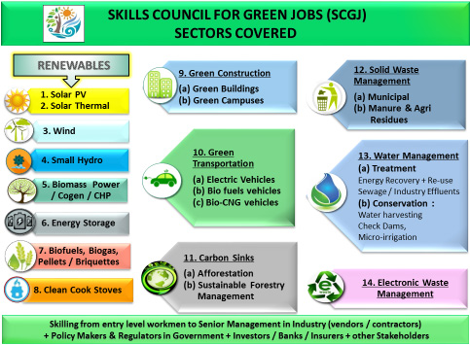
Green Jobs
WHAT - Green jobs are jobs that contribute to preserve or restore the environment, be they in traditional sectors such as manufacturing and construction, or in new, emerging green sectors such as renewable energy and energy efficiency.
WHY
To improve energy and raw materials efficiency
To limit greenhouse gas emissions
To minimize waste and pollution
To protect and restore ecosystems
To support adaptation to the effects of climate change

Slide 4
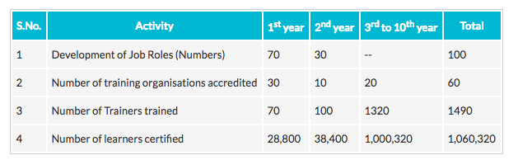
Skill Council for Green Jobs - Objectives

Slide 5
Problem Statement - Key Points
Skill India Mission - GOI Initiative - skilled manpower across different sectors
The organization responsible for the Renewable Energy Sector is the Sector Skill Council for Green Jobs (SCGJ)
SCGJ has affiliated training partners - institutions providing trainings on Qualification Packs (QPs) across all centres in India
Candidates register at a training partner centre to get trained on a particular QP, are assigned a batch
After completion of batch, an assessment partner affiliated to an affiliation agency conducts an exam
Reports for evaluated candidates generated, certified candidates are issued certificates

Slide 6
Assumptions
One candidate can apply for multiple Qualification Packs (QP), allotment will be done on the basis of the candidate’s preference (training partners and order of requested QPs).
One training partner has many training centres across the country
One training centre has many trainers and offers multiple qualification packs
One batch is trained on one qualification pack by one trainer
One assessor affiliated to an assessment partner goes to a training centre to assess a batch
The date of assessment of a batch and the date of declaration of its result may vary
The passing criteria for a candidate to be certified is 50%
The GOI coordinates with the training and assessment partners regarding their compensation, our database does not include these transactions
The employment initiatives undertaken by the GOI for certified candidates are beyond the scope of our database

Slide 7
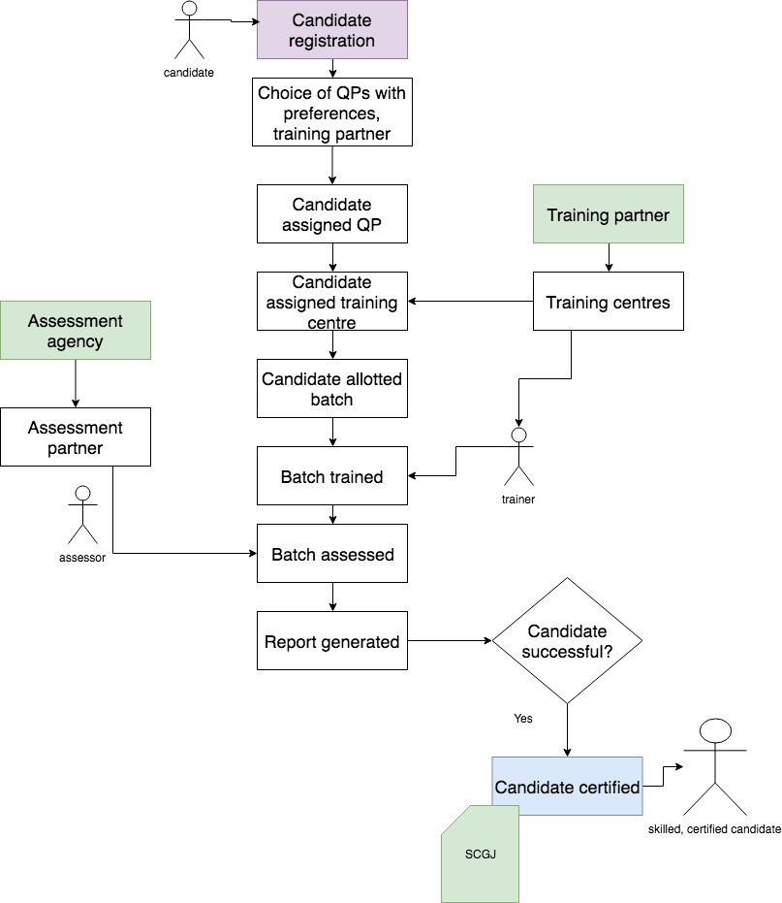
Workflow

Slide 8


Tools & Platform

Slide 9
List Of Tables Created
Assessment_agencies
Assessor
Batch
Candidate
Candidate_batch_details
Candidate_request_qp
Certified_candidate
Exam
Report
Location
Qualification_pack
Question
Sector
Trainer
Training_center
Training_center_qpmap
training _partner
trainingpartner_qpmap
SCGJ

Slide 10
Database Schema

Slide 11
Asking the Appropriate Questions
What | Why
State-wise representation of certified candidates | Analyze candidate performance across states, and their employment prospects
State-wise representation of failed candidates | Identify possible factors for unsatisfactory performance across states
State-wise representation of total candidates | Analyze the demand for SCGJ across states
Details of candidates who scored the maximum marks in their QP in 2017 | Award top scorers, incentivize skill learning
List of batches assessed by a particular assessment agency | Analyze historic assessment records and performance of an agency

Slide 12
What | Why
Total number of QPs offered by a specific training partner | Identify areas that training partners can work on
QP with the number of enrollments | Analyze the demand and relevance of QPs
Candidates having qualification<5 | To see the willingness of people towards project.
Number of enrolled candidates that haven’t yet been assigned batches | Group enrolled candidates together based on allotted QPs, so that training can commence
Finished batches waiting for assessment | Allot assessment partners to finished batches

Slide 13
SQL Queries

Slide 14

Thank you!

